Slide 1
Fourier series
Da Zhou （周达）
zhouda@xmu.edu.cn

Slide 2
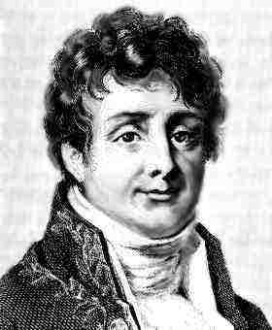
Joseph Fourier 1768-1830

Slide 3
Periodic Function

Slide 4
Periodic Function
A function
is periodic
if it is defined for all real
and if there is some positive number,
such that
.

Slide 5
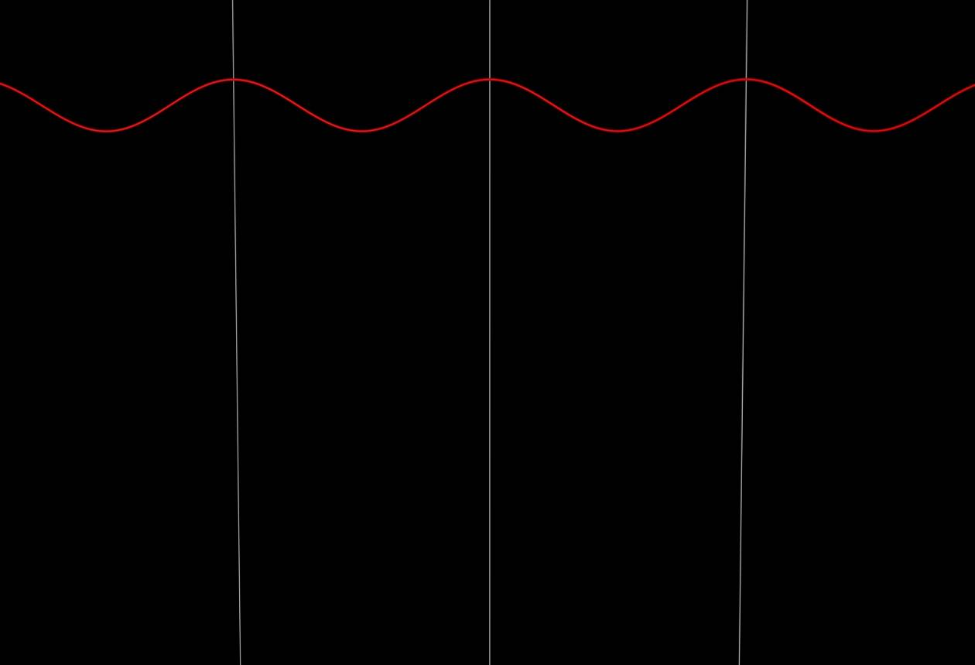
Light pulses
A plane wave with a single frequency

Slide 6
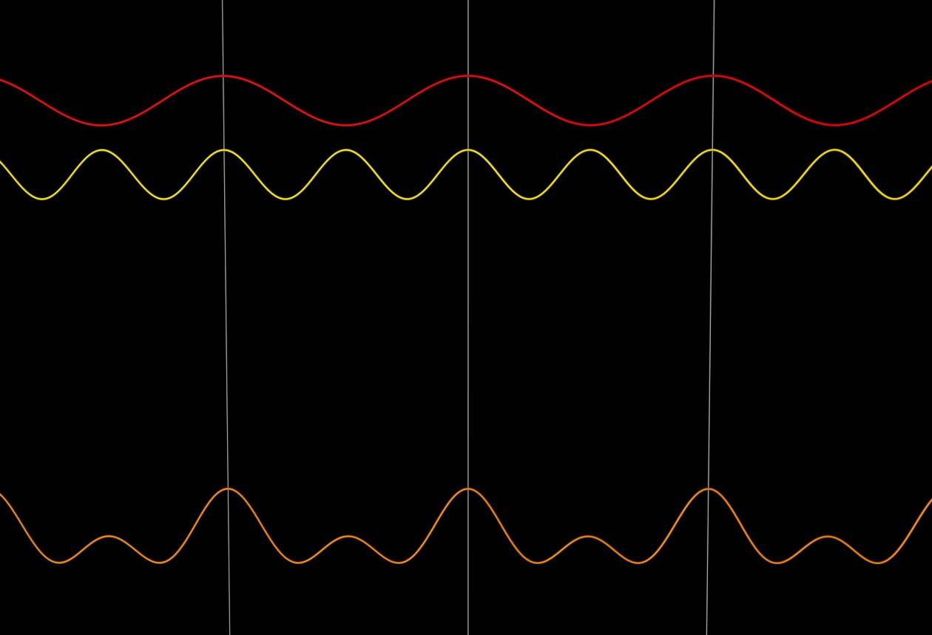
Light pulses
Add a second plane wave at a different frequency

Slide 7
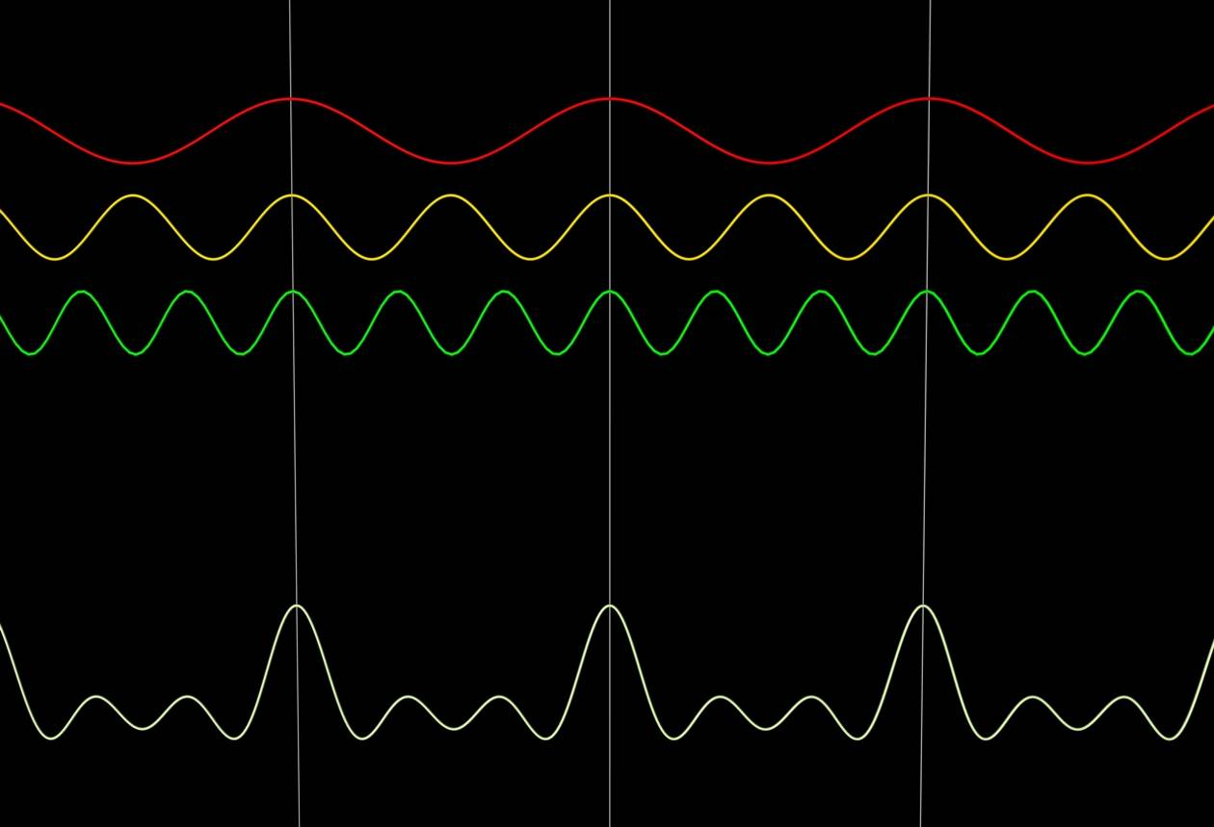
Light pulses

Slide 8
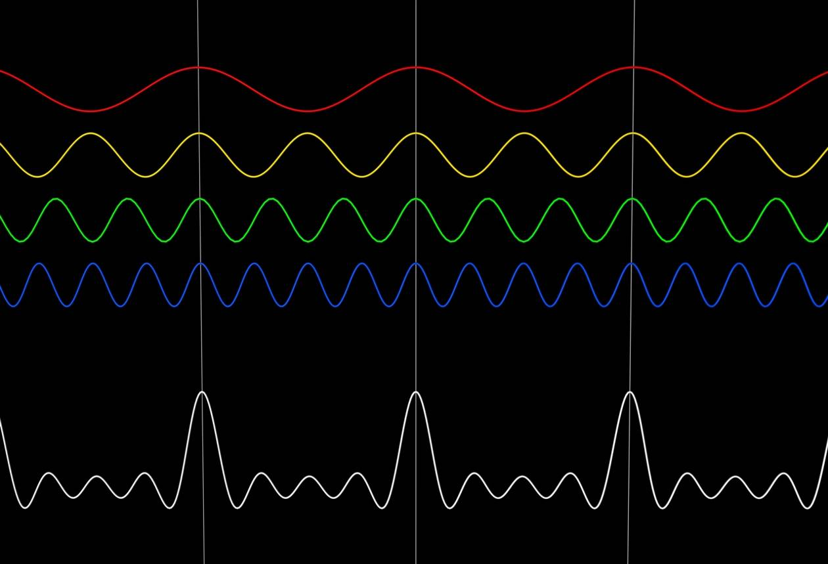
Light pulses

Slide 9
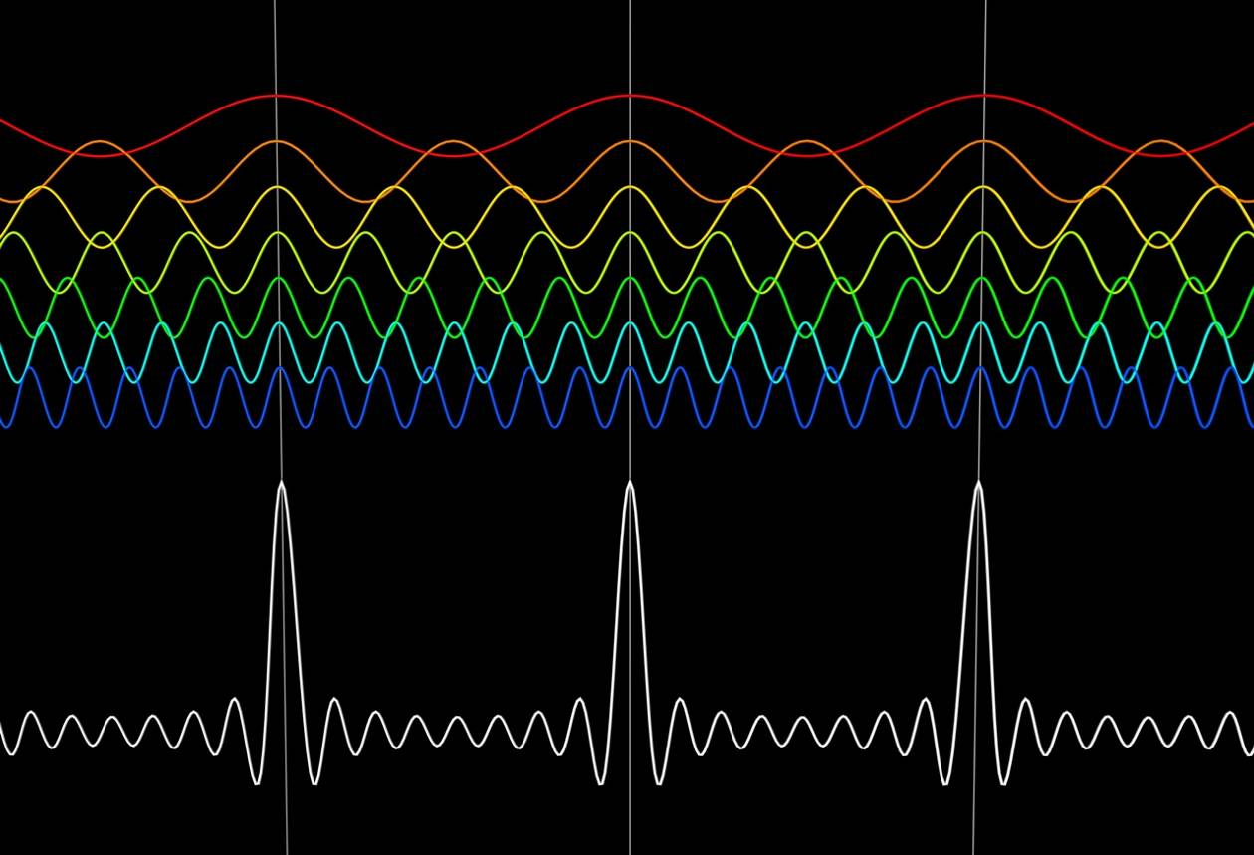
Light pulses
A large combination of plane waves can result in a short light pulse
Note that this signal is periodic, as we used a discrete set of waves

Slide 10
Fourier series
be a periodic function with period
If the function can be represented by a trigonometric series as:
注意：在同济版的教材里面，用a₀/2表示常数项，所以跟我们这里的表示略微不同，虽然没有本质区别，但计算时请大家务必留心！！
then we the series is the Fourier series of f.

Slide 11
Dirichlet condition
A piecewise regular function that
1. Has a finite number of finite discontinuities and
2. Has a finite number of extrema in a period
can be expanded in a Fourier series which converges to the function at continuous points and the mean of the positive and negative limits at points of discontinuity.

Slide 12
What kind of trigonometric (series) functions are we talking about?

Slide 15
for all values of m.

Slide 16
Orthogonality of functions
The scalar product of two functions f(x) and g(x) deﬁned on the same interval [a, b] can be deﬁned by
The functions f(x) and g(x) are said to be orthogonal on the interval [a, b] if

Slide 17
Determine

Slide 19
Determine

Slide 20
Let us do the integration on the right-hand-side one term at a time.
First term,
Second term,

Slide 21
Second term,
Third term,

Slide 22
Therefore,

Slide 23
Determine

Slide 24
The coefficients are:

Slide 25
We can write n in place of m:

Slide 26
Example 1. Find the Fourier series of the following periodic function.

Slide 32
Therefore, the corresponding Fourier series is
In writing the Fourier series we may not be able to consider infinite number of terms for practical reasons. The question therefore, is – how many terms to consider?

Slide 33
When we consider 4 terms as shown in the previous slide, the function looks like the following.
1.5
1
0.5
f
(
θ
)
0
0.5
1
1.5
θ

Slide 34
When we consider 6 terms, the function looks like the following.
1.5
1
0.5
f
(
θ
)
0
0.5
1
1.5
θ

Slide 35
When we consider 8 terms, the function looks like the following.
1.5
1
0.5
f
(
θ
)
0
0.5
1
1.5
θ

Slide 36
When we consider 12 terms, the function looks like the following.
1.5
1
0.5
f
(
θ
)
0
0.5
1
1.5
θ

Slide 37
The red curve was drawn with 12 terms and the blue curve was drawn with 4 terms.
1.5
1
0.5
0
0.5
1
1.5
θ

Slide 38
The red curve was drawn with 12 terms and the blue curve was drawn with 4 terms.
1.5
1
0.5
0
0.5
1
1.5
0
2
4
6
8
10
θ

Slide 39
The red curve was drawn with 20 terms and the blue curve was drawn with 4 terms.
1.5
1
0.5
0
0.5
1
1.5
0
2
4
6
8
10
θ

Slide 40
Even Functions
The value of the function would be the same when we walk equal distances along the X-axis in opposite directions.
Mathematically speaking -

Slide 41
Odd Functions
The value of the function would change its sign but with the same magnitude when we walk equal distances along the X-axis in opposite directions.
Mathematically speaking -

Slide 42
The Fourier series of an even function
is expressed in terms of a cosine series.
The Fourier series of an odd function
is expressed in terms of a sine series.

Slide 43
Example 2. Find the Fourier series of the following periodic function.

Slide 45
Use integration by parts.

Slide 47
This is an even function.
Therefore,
The corresponding Fourier series is

Slide 48
Odd and Even Extensions
Expand the following function as sine series and cosine series respectively.

Slide 49
Functions Having Arbitrary Period T？

Slide 53
Example 4. Find the Fourier series of the following periodic function.

Slide 54
This is an odd function. Therefore,

Slide 55
Use integration by parts.

Slide 56
when n is even.

Slide 57
Therefore, the Fourier series is

Slide 58
The Complex Form of Fourier Series
Let us utilize the Euler formulae.

Slide 59
Denoting
and

Slide 60
The Fourier series can be expressed as:

Slide 61
Functions defined on entire real line without any periodicity？

